Slide 1
Unclassified Cover Slide
DLA Distribution
Industry Partnership Plan
Meg Ross, Director
DLA Distribution Acquisition Operations​
March 2026
Last updated: March 2026

Slide 2
Title and Date: Name of The Engagement
Slide Classification: Classification goes here
Purpose:
Communicate how DLA Distribution will approach engagement with suppliers of both products and services
Agenda:
Mission and Vision
Overview
Supplier Survey
Workload Overview
Supplies
Services
Small Business Operating Plan
Industry Partnership Plan
Briefing Type:
  Information

Slide 3
Mission and Vision
MISSION: Deliver comprehensive acquisition solutions to the global distribution network
VISION: To be the leader in every facet of acquisition
OUR COMMITMENT:
Our Team is First Provide opportunities for professional and personal growth establishing an environment for success. Team members are our most valuable resource, professional
acquisition employees cannot be mass produced.
Our Customers Satisfy our customers in terms of cost, quality and timeliness of the delivered product or service. Deliver superior results with initiative, consistently exceeding expectations.
Leadership Know, value and be accountable to our team. Be the organization’s greatest champion, celebrating accomplishments. Talk the talk and walk the walk.
Stewardship Safeguard taxpayer’s dollars, conducting business with integrity, fairness, and openness; minimizing operating costs. Meet public policy objectives and deliver quality work with personal responsibility and accountability.
Communication Information will be passed up down and across the organization to enhance productive interpersonal relationships among team members, leadership, and customers.
Knowledge Sharing Build positive relationships among and across the team through collaboration, sharing best practices, and embracing diverse perspectives to strengthen decision making. Knowledge sharing is an asset and vital to our success

Slide 4

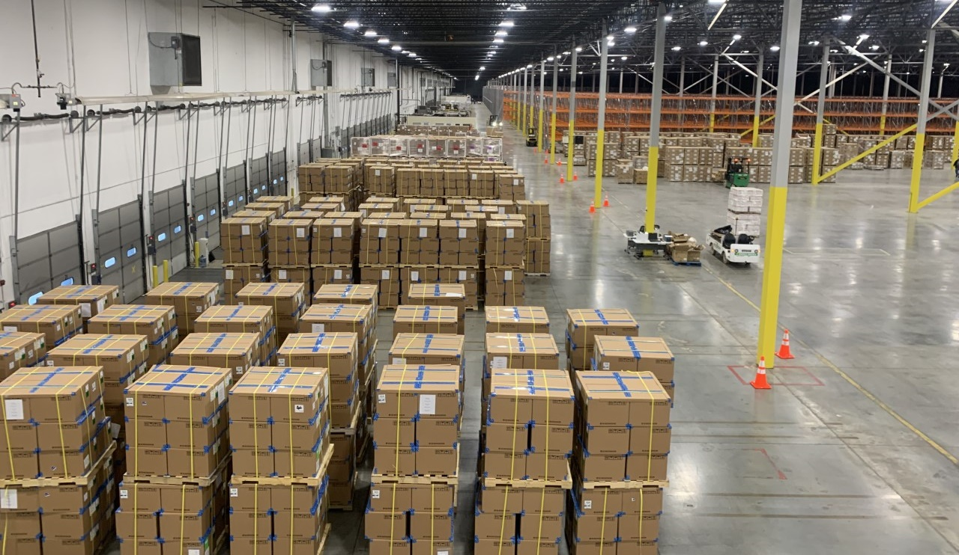

Overview
PROVIDING AGILITY AND FLEXIBILITY TO THE DISTRIBUTION NETWORK
FY25: 919 CONTRACTS ISSUED, $483.2M OBS, ~$2.7B VALUE
OPERATIONAL CONTRACTS
  GOCO Distro Centers (10)
  Global Distro Expeditionary Contract (~12 TOs per yr)
  Commercial MRE & Cold Storage (3)
  HAZMAT 3PL (5)
  Retail (4 stand-alone locations)

Slide 5


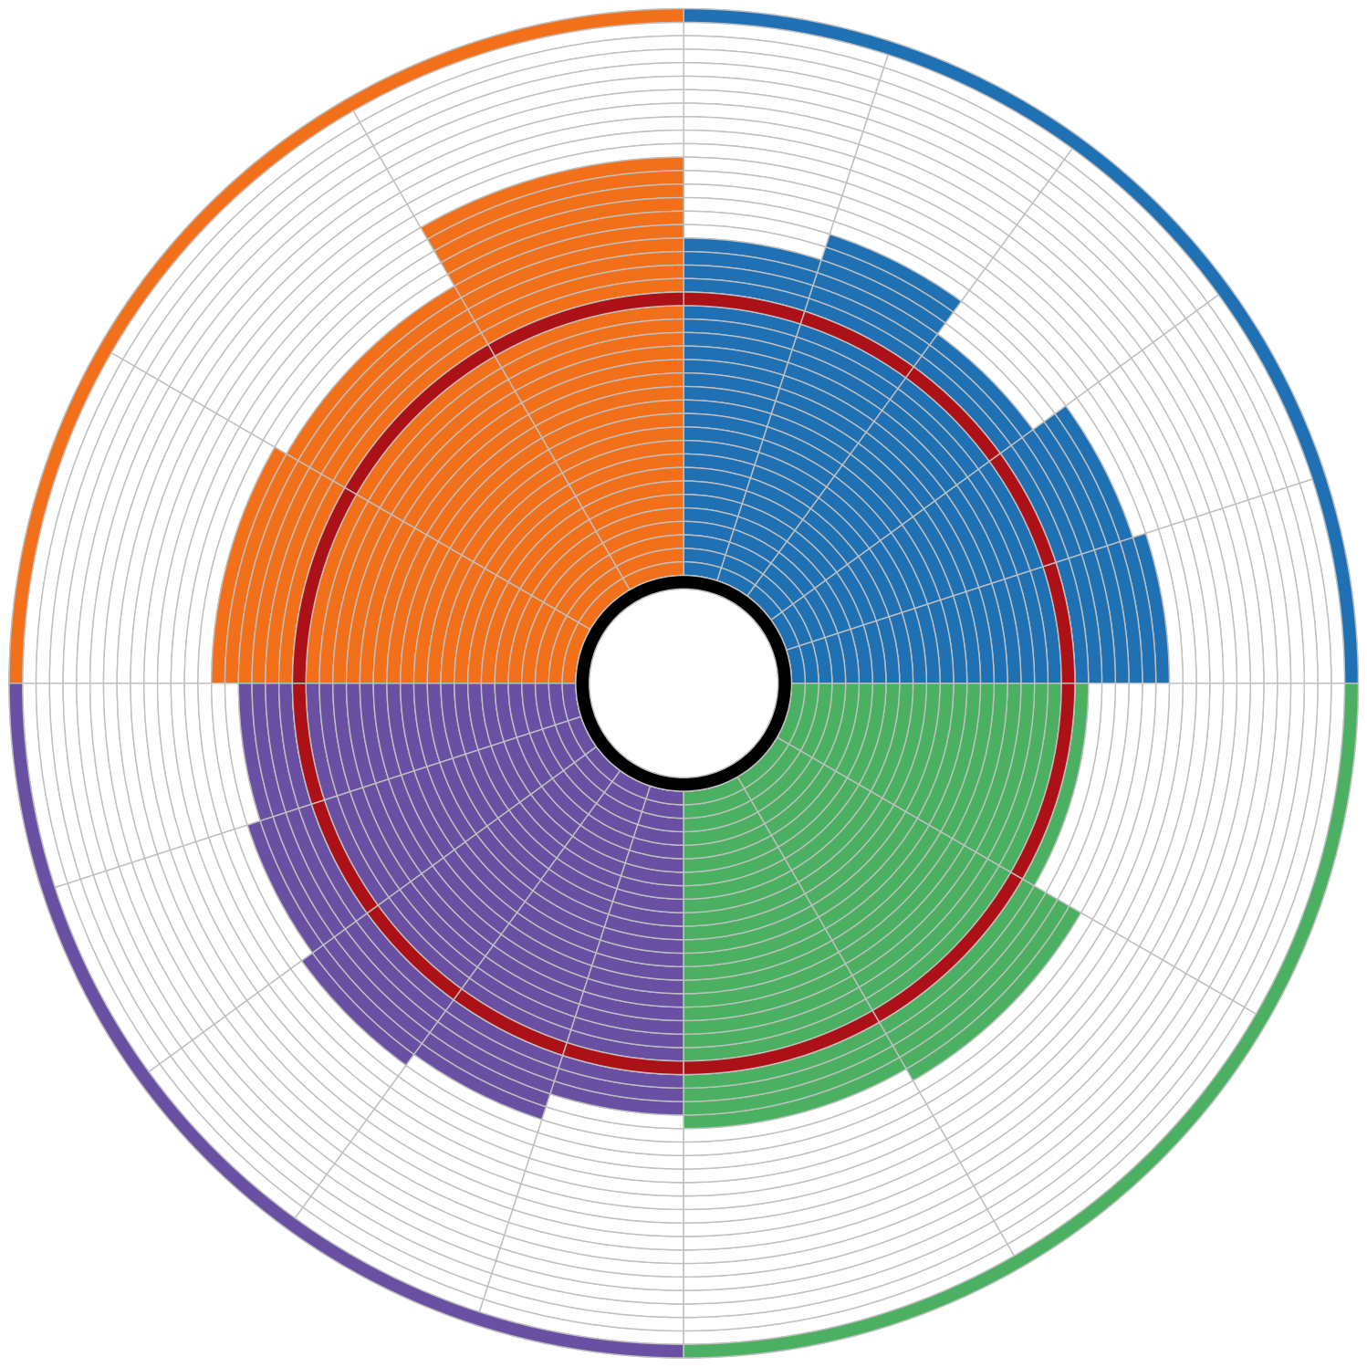


Supplier Survey
2024 Distribution Results
Increase Decrease No Change
116 Respondents (2022: 72)
+.06
Trustworthy
Accessibility
+.04
-.04
4.03
3.42
Equitable Resolution
-.03
Timely
3.65
DLA-Supplier Relationship
-.01
DLA Communication
Timely Resolution
3.50
3.30
Effective Resolution
-.03
3.58
-.06
Adequate
3.59
Valued Supplier
3.71
-.08
3.50
+.15
Pre-Award Effectiveness
3.37
3.12
2022 Score: 3.47
-.16
Ease of Bidding
3.49
+.06
Post Award Effectiveness
3.57
3.52
+.17
Industry Knowledge
3.52
Profit Opportunity
+.10
3.29
3.42
+.24
Supplier Knowledge
Growth Opportunity
Growth and Profit Potential
DLA Effectiveness
-.01
Innovation
-.01
5

Slide 6
Supplier Survey
2024 Distribution Results
Maximize use of Combined Synopsis Solicitations
Moving Forward:
Develop Instructions as critical Checklist
Limit vendor submissions to critical info to determine acceptability
Utilize past performance record to determine performance capabilities
Explore automated receipt of offers
Ease of Bidding
Reviewed Instructions to Offerors and Evaluation Criteria
across Various Procurement
Held internal workshops; streamlined submissions
Reduce number of factors and subfactors
Apply use of commercial procedures vice FAR 15, when appropriate
Limit proposal submission size – focus on page counts and narrative reqts
Consider multiple award IDIQ to allow pricing flexibilities during contract term
Reduce vendor investment in proposal submissions
Streamline evaluation time and award decisions
6
Notes:
Consistent Trends
Ease of Bidding
Innovation
Timely Resolution
What We’ve Done
Simplified Combined Synopsis/Solicitations – relook at Instructions/Evaluation Criteria
Increased Indefinite Delivery Contracts
Issued RFI for vendor feedback
Longer RFP issuance
Audit Readiness Requirements Modernization
What’s Next/How Can You Help
Vendor one-on-ones with Contracting Officers
Revisit RFI – seeking additional feedback on Distribution Center requirements – target Ease of Bidding/Innovation feedback
Contract Specialist/Contracting Officer as starting point for issue resolution

Slide 7
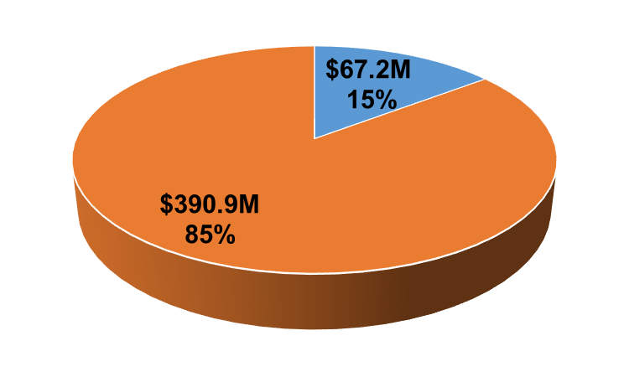
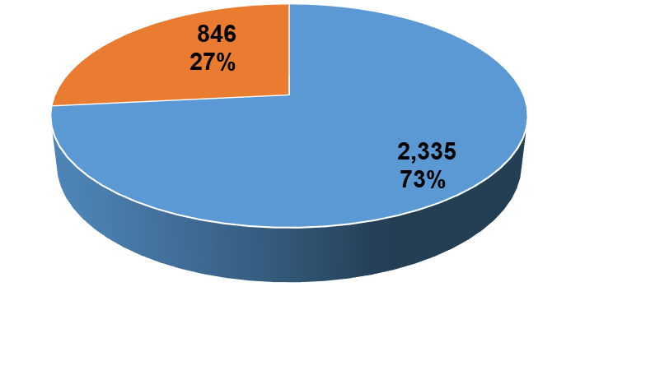
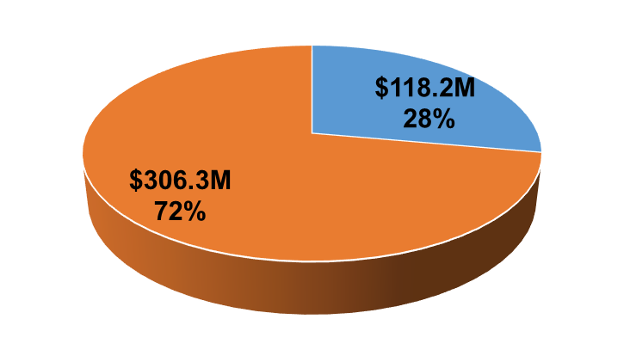
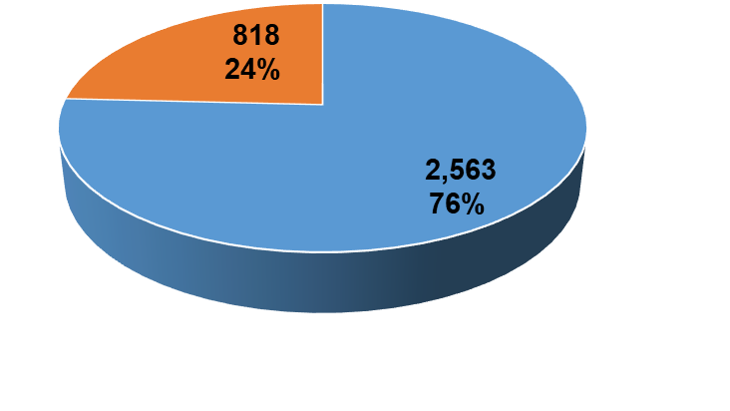

Workload Overview
3,181 Actions
$458.1M Net Obligations
FY2
5
3,381 Actions
$424.5M Net Obligations
FY
2
4

Slide 8
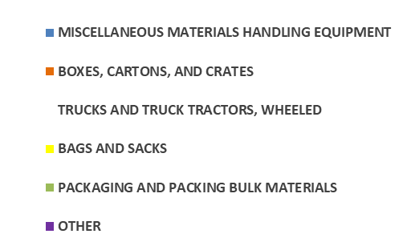
Supplies
Operational
  Boxes & Envelopes
  Packaging Material (bubble wrap, sealed air)
  Pallets
Automated Material Handling Equipment
Modernization/Communications
Office Supplies (tape, labels)
Facilities Upgrades
Racking
FY 25 Obligations $70.8M
FY 25 Actions 2,335

Slide 9
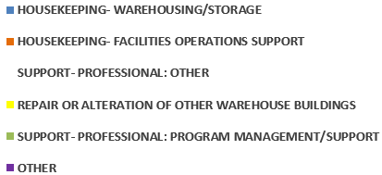
Services
Distribution Operations
  10 GOCOs/COCOs
  S&D of MRE, FF&V
  Labor Augmentation
  3PL Haz Material Support
Global Distribution Expeditionary Contract
Professional Services
Facilities
  Equipment Maintenance & Repair
  Janitorial
  Facilities Maintenance & Repair
Construction
FY25 Obligations $412.3M
FY25 Actions 846

Slide 10
Small Business Operating Plan
DLA Distribution’s Intent
Maintain a secure and resilient industrial base inclusive of small and socioeconomic businesses
Support the small business program initiatives by meeting small business and socioeconomic goals and monitoring and enforcing contractor subcontracting plan goals
Support a strong, dynamic, and robust small business defense sector
DLA Distribution’s SB Plan aligns with DLA Strategic Plan
Support the Industrial Base
Strong Partnerships
Skilled and Agile Workforce
Stewardship and Accountability
Metrics to performing against the SB Plan:
Increase Number of SB New Entrants
Increase Socio-economic Participation
Provide SB Training to Acquisition Professionals
Meet SB (56%) and Socio-economic Goals
Participate in Small Business Engagements

Slide 11

Industry Partnership Plan
DLA Director’s Intent
DLA Industry Engagement Plan (IEP) reissued as DLA Industry Partnership Plan (IPP)
DLA’s IPP outlines a strategy for a transformative era that reinforces our commitment to strengthening our partnership with industry in support of our Warfighters
Recognizes how critically important our partnership with industry is in driving innovation, fostering creativity, and delivering solutions, especially as we navigate logistics challenges in today’s contested environments
DLA Distribution J7’s IPP builds off of
DLA HQ’s IPP 4 Transformative Imperatives
People – Build organizational agility through our people and culture
Precision – Calibrate resilient and responsive logistics in support of military readiness
Posture – Enhance support to integrated deterrence across the continuum of conflict in contested logistics environments
Partnerships – Lead logistics interoperability across the Departments, allies, whole of government, and industrial base
Metrics to performing against this plan include:
Reissue DLA Distribution’s IEP as IPP
Manage Acquisition performance
Meet SB (56%) and Competition (88%) Goals
AbilityOne engagement
Strategic Supplier engagement
Participate in DLA HQs Association Webinar
Distribution presence at IE events
Planning for next DLA Distribution Industry Day to be tentatively held FY 2027 3rd QTR

Slide 12
Unclassified End Slide: Option 1

